Slide 1


Demo Salesforce Progress
Aslene OUAZE

Slide 2
TABLE OF CONTENTS
01
02
Lightning web components basics
Lightning web components and data
03
Lightning web components tests

Slide 3


01
Lightning web components basics

Slide 4
Lightning web components basics
Lightning Web Components is a new programming model for building Lightning components.
It uses web standards breakthroughs, can coexist and interoperate with the Aura programming model, and delivers unparalleled performance.
We don't need to ramp up on quirks of a particular framework. We simply create components using HTML, JavaScript, and CSS.

Slide 5
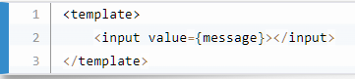
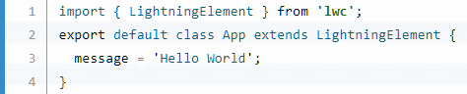
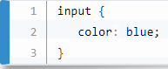
Lightning web components basics
HTML provides the structure for our component.
JavaScript defines the core business logic and event handling.
CSS provides the look, feel, and animation for our component.

Slide 6
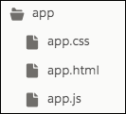
Lightning web components basics
A component simply needs a folder and its files with the same name. They're automatically linked by name and location.

Slide 7
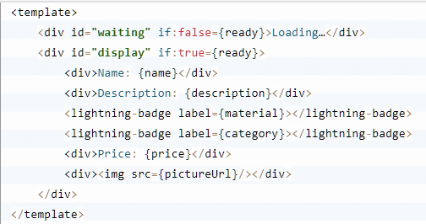
Lightning web components basics
Lightning web component HTML files all include the template tag. The template tag contains the HTML that defines the structure of our component.

Slide 8
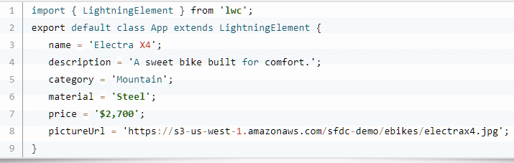
Lightning web components basics
Corresponding app.js file:

Slide 9
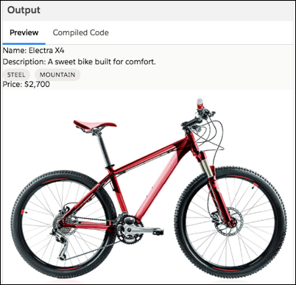
Lightning web components basics
Corresponding output:

Slide 10
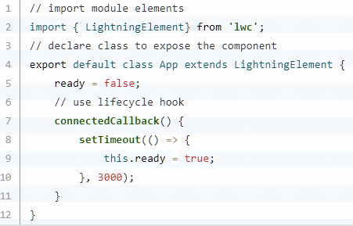
Lightning web components basics
Working with JavaScript (The LWC Module)
LightningElement is the base class for Lightning web components, which allows us to use connectedCallback().
The connectedCallback() method is one of our lifecycle hooks.
That the method is triggered when a component is inserted in the document object model (DOM). In this case, it starts the timer.

Slide 11
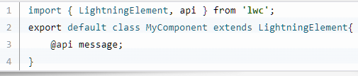
Lightning web components basics
Decorators
Decorators are often used in JavaScript to modify the behavior of a property or function.
To use a decorator, import it from the lwc module and place it before the property or function.

Slide 12
Lightning web components basics
Decorators
Examples of Lightning Web Components decorators include:
@api: Marks a field as public. The framework observes the property for changes. When the property's value changes, the framework reacts and rerenders the component.
@track: Tells the framework to observe changes to the properties of an object or to the elements of an array. If a change occurs, the framework rerenders the component. All fields are reactive. We use @track only if a field contains an object or an array
@wire: Gives us an easy way to get and bind data from a Salesforce org.

Slide 13
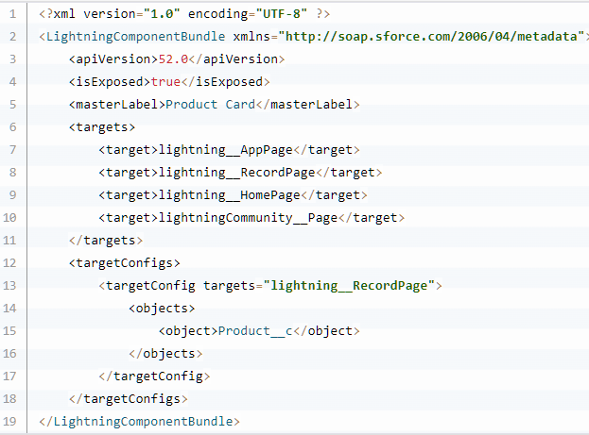
Lightning web components basics
Configuration file ( .js-meta.xml ):
This file provides metadata for Salesforce, including the design configuration for components intended for use in Lightning App Builder.

Slide 14
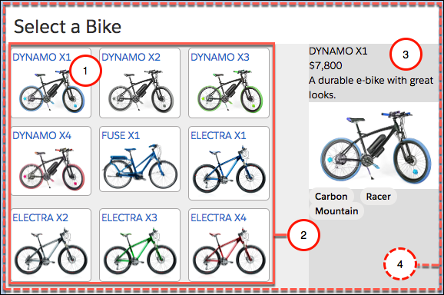
Lightning web components basics
Events
Starting with an example:
This app has four components working together.
tile: displays an individual item.
list: arranges the tiles.
detail: displays item details when a tile is clicked .
selector: contains the whole set of components.

Slide 15
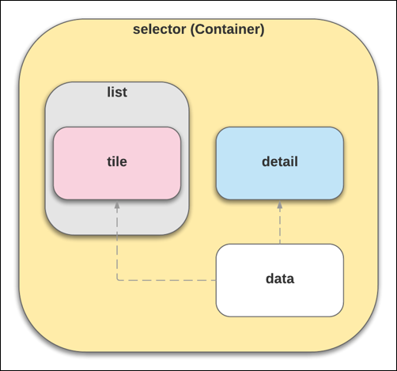
Lightning web components basics
Events
In this example, multiple components work together; some components are nested inside other components.
Lightning web components—which are custom HTML elements—can be nested inside other Lightning web components.

Slide 16
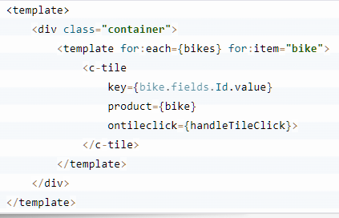
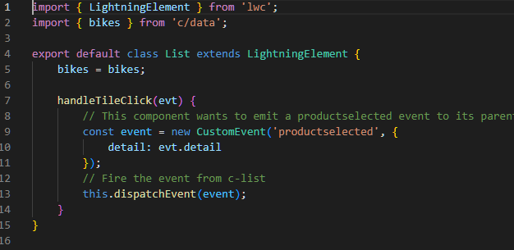
Lightning web components basics
Events

Slide 17
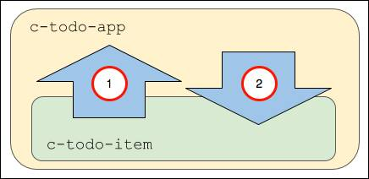
Lightning web components basics
Events
In a complex component (one that contains several parent and child components), the components can communicate up and down.
The c-todo-item child component dispatches an event to the parent c-todo-app component. For example, the child can pass an event object to the parent when a user clicks a button so the parent can handle the event and change the current page.
The c-todo-app parent component passes a property or invokes a method in the child component. For example, the parent can set a text value in a child component, or invoke a method in the child component.

Slide 18

02
Lightning web components and data

Slide 19
Lightning web components and data
Read or Modify Data with Record Form Base Components
The easiest way to work with single records in Lightning web components is to use the lightning-record-*-form
These base components use Lightning Data Service behind the scenes and inherit its caching and synchronization capabilities. Each base component gives you different features and levels of customization:
lightning-record-form base component is the simplest one. With lightning-record-form, we can specify a layout and allow admins to configure form fields declaratively.
lightning-record-view-form base component allows you to view records.
lightning-record-edit-form base component allows you to edit records.

Slide 20
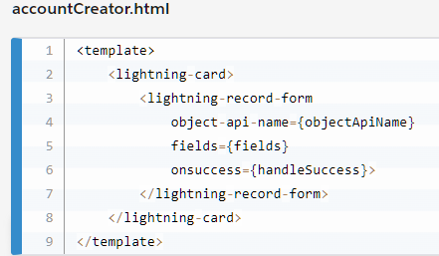
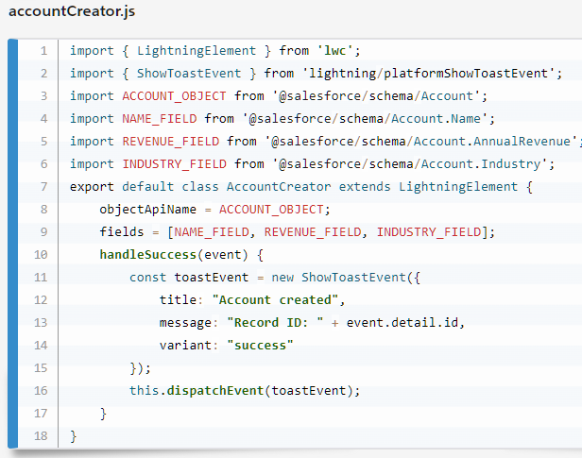
Lightning web components and data

Slide 21
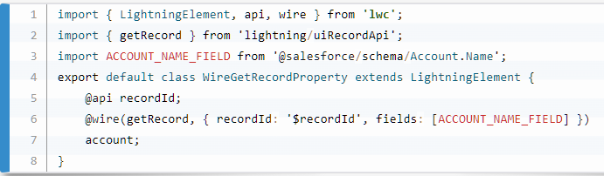
Lightning web components and data
Read Data with LDS Wire Adapters
LDS wire adapters are another way to work with Salesforce data.
We use a wire adapter to read Salesforce data (records) and metadata (layout details, fields on an object, and so on).
To use them, decorate a property or function with @wire and specify the wire adapter.

Slide 22
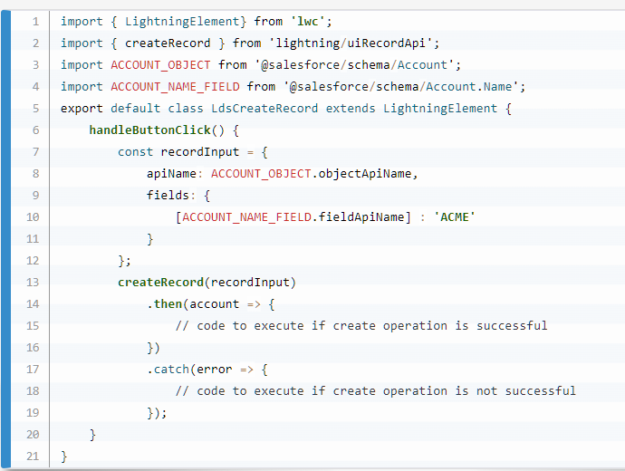
Lightning web components and data
Modify Data with LDS Functions

Slide 23

03
Lightning web components tests

Slide 24

THANKS!
Do you have any questions?

